Slide 1
Erector spinae plane block

Slide 2
Outlines
Introduction Anatomy and physiology of erector spinae plane block (ESPB) Indications and contraindications of ESPB Equipments Techniques or treatments Complications

Slide 3
Objectives
Identify the indications for erector spinae plane block.
Describe the patient anatomy and technique for an erector spinae plane block.
Outline the potential complications of an erector spinae plane block.
Understand the importance of preparing and performing an ESP block to enhance patient safety and satisfaction.

Slide 4
Introduction
The erector spinae plane (ESP) block is used to provide analgesia for a variety of surgical procedures or to manage acute or chronic pain.
The technique is relatively easy to perform on patients.
It is performable with minimal or no sedation in the pre-operative holding area.
The ESP block can is possible either using a single-injection technique or via catheter placement for continuous infusion.

Slide 5
Cont...
The block was used to manage thoracic neuropathic pain in a patient with metastatic disease of the ribs and rib fractures.
It also successful in multitude of procedures including :-
Nuss procedure
Thoracotomies
Percutaneous nephrolithotomies
Ventral hernia repairs, and
Lumbar fusions.

Slide 6
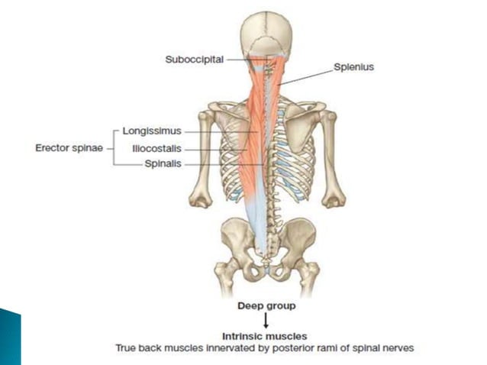
Anatomy and physiology of ESPB
Erector spinae muscles comprises the intermediate layers of the deep( intrinsic) muscles of the back.
Extends on either sides of the vertebral column, between the base of cranium superiorly and pelvis inferiorly .
It is divided into 3 groups, from medial to lateral:-
Spinalis
Longissimus
Iliocostalis

Slide 7
Cont’d...
The ESP lies between the fascia covering the anterior aspect of the erector spinae muscles and the posterior surface of the transverse processes of the vertebrae. They run on either side of the spinous processes of the vertebral column from the base of the skull to the pelvis. Their caudal insertions are on the sacrum, iliac crest and lumbar spinous processes. Cranial insertions are at transverse and spinous processes of the thoracic and cervical vertebrae up to C2, as well as attachments to ribs.

Slide 8
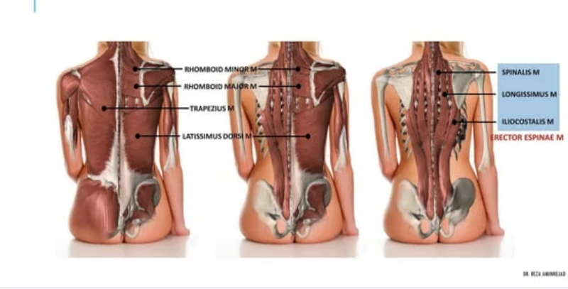
.....
ESM are overlaid by other superfcial posterior back muscles:
The thoracic region, overlaid by the trapezius and rhomboid major muscles.
The rhomboid major muscle tapers at approximately T5, so may not be visualized during blocks performed at or below this level
In the lumbar region, overlaid by the serratus posterior inferior and latissimus dorsi

Slide 9
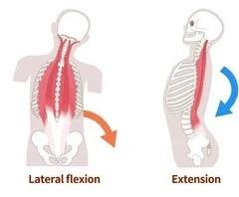
Cont...
Function: used to move the vertebral column. Bilateral contraction help to extend the spine, while Unilateral contraction causes lateral flexion (ipsilateral) It also helps to maintain posture by steady the weight on pelvis during walking

Slide 10
Communication:
The ESP communicates with the thoracic paravertebral and epidural spaces through the intertransverse connective tissues.
The dorsal border of the thoracic paravertebral space has fenestrations which may allow spread of local anesthetic (LA) into the paravertebral space from more superficial injection within the ESP.
The ESP also communicates with intercostal spaces laterally.

Slide 11
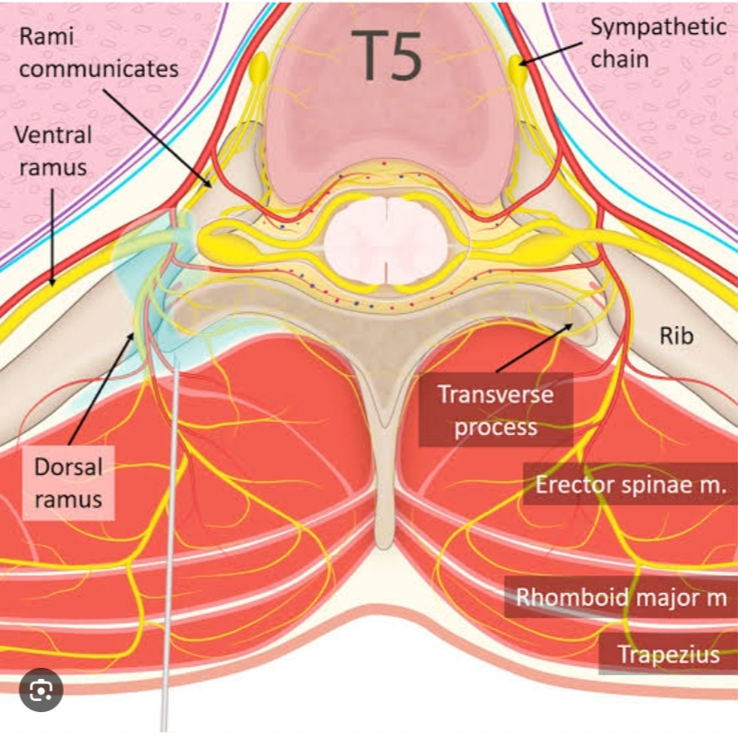
Nerves:
In the thoracic spine, spinal nerves exit the vertebral canal and continue as ventral and dorsal rami within the ESP.
In the lumbar region, the ventral rami of L1 to L4 form the lumbar plexus, and the dorsal rami split into medial, intermediate, and lateral branches.

Slide 12
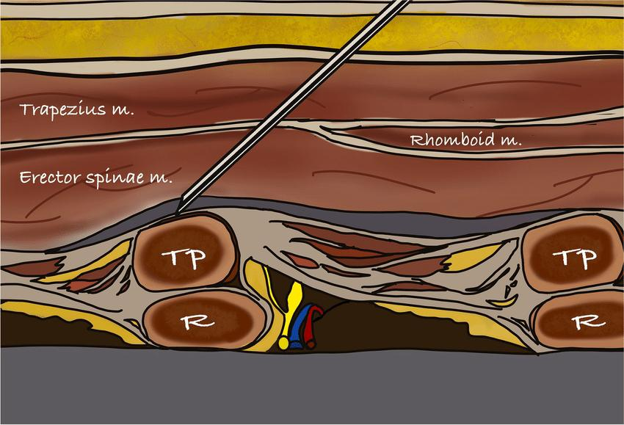
Erector spinae plane
ESP :- is located deep to the erector spinae muscles, between the transversospinalis muscles and the vertebral lamina or simply between ESM and transverprocess of the vertebra.
Is a place where needle placement and local anesthetic distribution during ESPB

Slide 13
Esp Block
The aim of ESP block is deposit local anesthetics in to the facial plane deep to erector spinae muscle, which blocks the dorsal and ventral rami of the spinal nerve depending on the level of injection and the amount of local anesthetics injected. The spinous process of the vertebra and a point 3 cm lateral to it are marked at the appropriate level before performing the block.

Slide 14
Types of espb
1. Unilateral ESPB
Performed on one side of the spine.
Indications :- often used for unilateral thoracic or abdominal surgeries, such as rib fractures or thoracotomy.
2. Bilateral ESPB
Involves injecting local anesthetic on both sides of the spine. Indications :- useful for procedures requiring analgesia on both sides, such as bilateral thoracotomies or extensive abdominal surgeries.

Slide 15
Cont...
3. Thoracic ESP block
Administered at the thoracic levels (typically T5-T9).
Indications :- effective for thoracic surgery, chest wall pain, and rib fractures.
4. Lumbar ESP block
Targeted at the lumbar levels (usually L2-L4). Indications :- used for lower abdominal surgeries, lumbar spine procedures, or hip surgeries.

Slide 16
......
☆ ESP block with catheter:
Involves placing a catheter in the ESP space for continuous infusion of local anesthetic.
Indications :- provides prolonged analgesia for patients undergoing major thoracic or abdominal surgery.

Slide 17
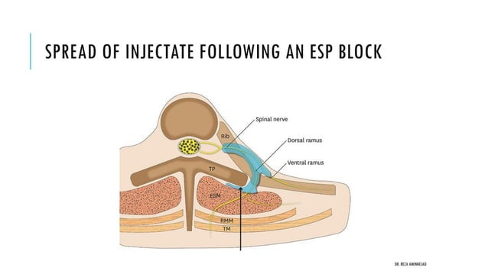
Mechanisms of action
The mechanism of action of ESP blocks is unclear. However, some studies suggest that :-
ESP block involves spread of LA and diffusion within the ESP, to the intercostal spaces and paravertebral spaces, and to adjacent neural structures (eg, spinal nerve roots, dorsal and ventral rami).
Spread to the epidural or paravertebral spaces, which would block sympathetic fibers, provides a mechanism by which the ESP block could provide visceral analgesia.

Slide 18
Indications
Breast surgery Thoracic surgery Rib fracture Abdominal surgery Spinal surgery Hip surgery As a PVB stepping stone

Slide 19
Contraindications
Patient refusal LA allergy Infection at the site of injection Difficult anatomy Anticoagulation

Slide 20
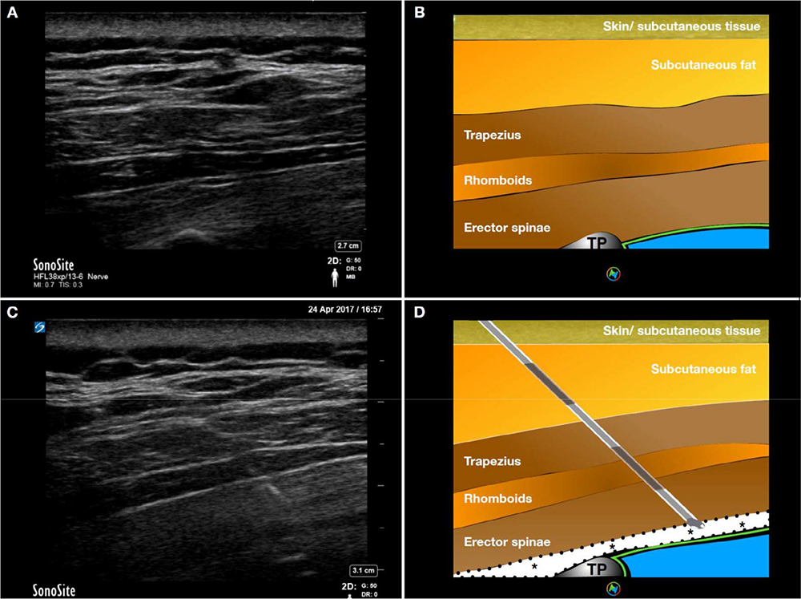
Landmarks for ESPB
Trapezius muscle
Rhomboid muscle
Erector spinae muscle
Transverse process of vertebral

Slide 21
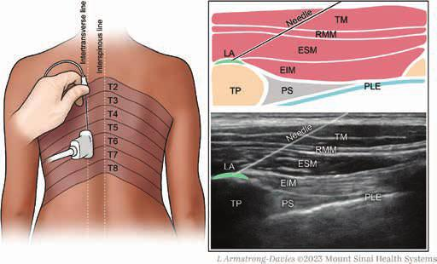
Site of injection:
The selected level for the block should be as close to the location for the dermatome for the incision or injury as possible.
Examples of block placement for various conditions and surgeries include the following:
•Upper thoracic – T2 to T3
•Lower thoracic – T5 to T7
•Abdominal surgery – T10
•Hip, femur, or lumbar spine surgery – L2 to L3

Slide 22
Equipments
Chlorhexidine gluconate Sterile gloves, mask, hair cover Convex or curvilinear ultrasound probe with sterile probe cover and gel Standard epidural catheter tray with a 3-ml syringe with lidocaine 1% on a 25-gauge needle,18-gauge Tuohy needle, and an epidural catheter (in the case of continuous infusion) ESP block local anesthetic solution (0.25% bupivacaine or 0.5% ropivacaine 20 to 30ml)

Slide 23
Techniques
1. Preparation
2.Positioning
The erector spinae plane block can be performed with the patient prone, upright, or in lateral decubitus.
Sitting position:- allows easy identification of landmarks and greater comfort to the patients
3. Scanning techniques
Select the target transverse process and place the transducer in a paramedian sagittal orientation, approximately 2-3 cm away from the midline.

Slide 24
Cont...
4. Identify the following structures on ultrasound: All 3 layers of the ESP muscles, the rib-transverse process complex of interest, and the paravertebral space. The pleura should not be visualized.
5. Insert the needle in-plane, from cranial to caudal, and inject 20-30 mL of local anesthetic in the plane deep to the ESP muscles and superficial to the transverse processes to achieve a craniocaudal distribution along several vertebral levels.
6. At this point, the needle tip lies between the erector spinae muscles and the transverse process

Slide 25
Cont...
7. The correct location of the needle tip is confirmed by injecting 0.5–1 cc of normal saline 0.9% and observing linear fluid spread lifting the erector spinae muscle off the tip of the TP.
8. After negative aspiration, LA is injected in 3 – 5 ml aliquots .
Then a volume of 20-25ml of 0.25% bupivacaine or 0.2% ropivacaine with or without adjuvants can be used.
9. The drug injected in this plane spreads in the longitudinal axis to both cephalad and caudal direction.

Slide 26
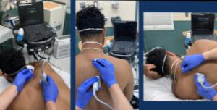
....

Slide 27
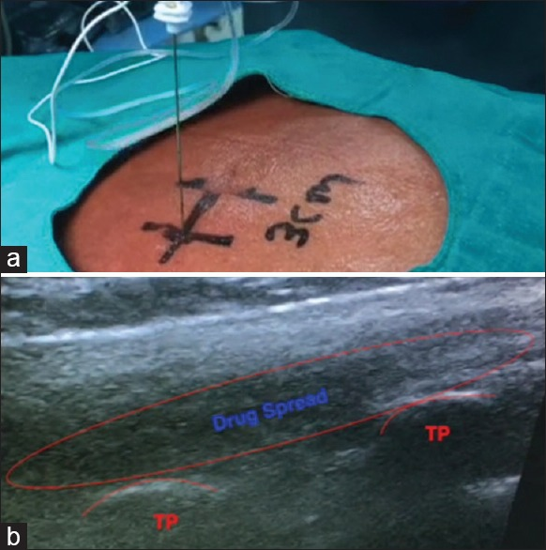

Slide 28
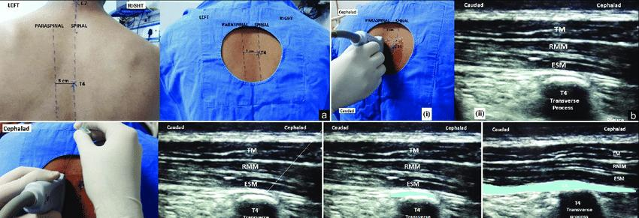
.....

Slide 29
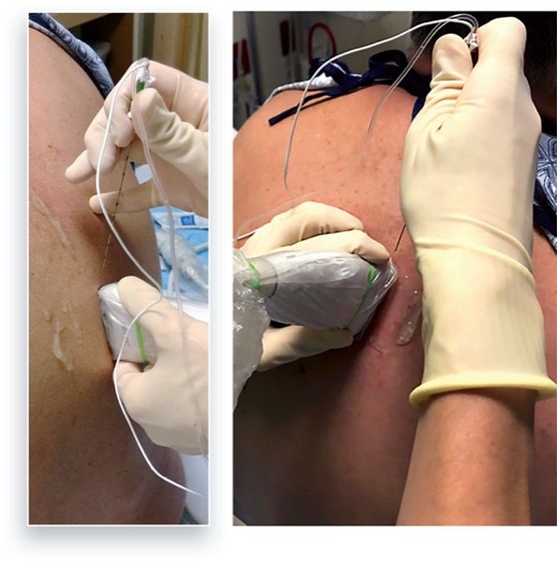
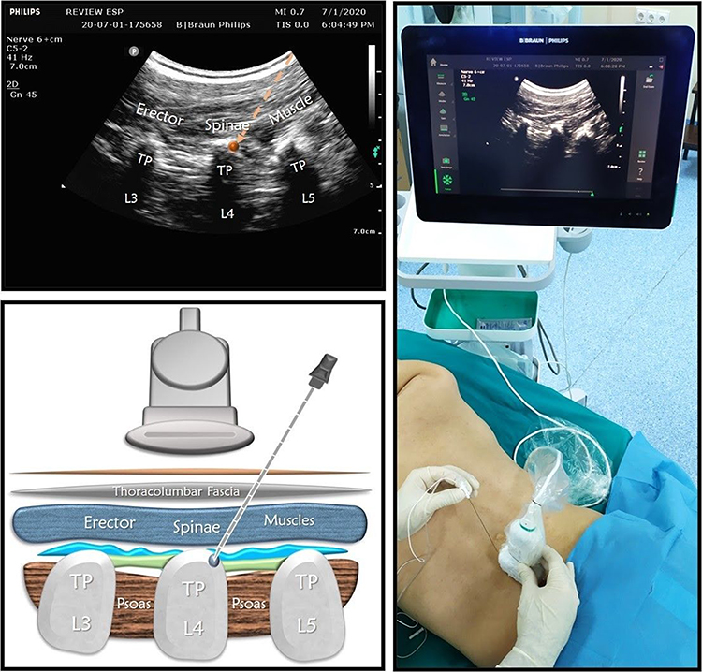
....

Slide 30
Verifying the Adequacy of Erector Spinae Plane Block Administration
Ultrasound guidance:
The correct location is confirmed by observing the linear spread of injectate lifting the erector spinae muscle off the tip of the transverse process.
Asymmetrical spread:
In a cadaveric study, bilaterally demonstrated craniocaudal spread of injectate from C7 to T8 on the right side and T1 to T8 on the left side, with lateral spread till the transverse processes at all levels.

Slide 31
.....
Visible linear pattern:
Injecting 10 mL of 0.25% bupivacaine into the interfascial plane deep to erector spinae muscle can produce a visible linear pattern lifting the muscle.
Confirmation of needle tip location:
Injecting 0.5-1 cc of normal saline 0.9% and observing linear fluid spread lifting the ESM off the tip of the transverse process confirms the correct location of the needle tip.
5. Clinical evaluation:
Post-procedure, patients can be evaluated for signs of effective analgesia, such as reduced pain scores, decreased opioid consumption, and improved mobility.

Slide 32
LA dose and volume
Maximum volume of LA for unilateral and bilateral blocks are 20-30 and 60 ml respectively.
The volume of LA in pediatric patients ranges from 0.2 ml/kg to 0.5 ml/kg .

Slide 33
Complications
Pneumothorax
Lower extremity weakness
LA systemic toxicity
Hemorrhage
Hematoma formation
Nerve injury

Slide 34
Home take message:
ESP block is successful alternative techniques to thoracic epidural anesthesia with a minimal risk of serious complications such as epidural hematoma and epidural abscess.
Further research is still required to standardise doses and concentration of local anesthetics and to compare ESP block with other regional techniques.

Slide 35
Summary
The aim of ESP block is deposit local anesthetics in to the facial plane deep to erector spinae muscle, which blocks the dorsal and ventral rami of the spinal nerve depending on the level of injection and the amount of local anesthetics injected.
The spinous process of the vertebra and a point 3 cm lateral to it are marked at the appropriate level before performing the block.

